Slide 1
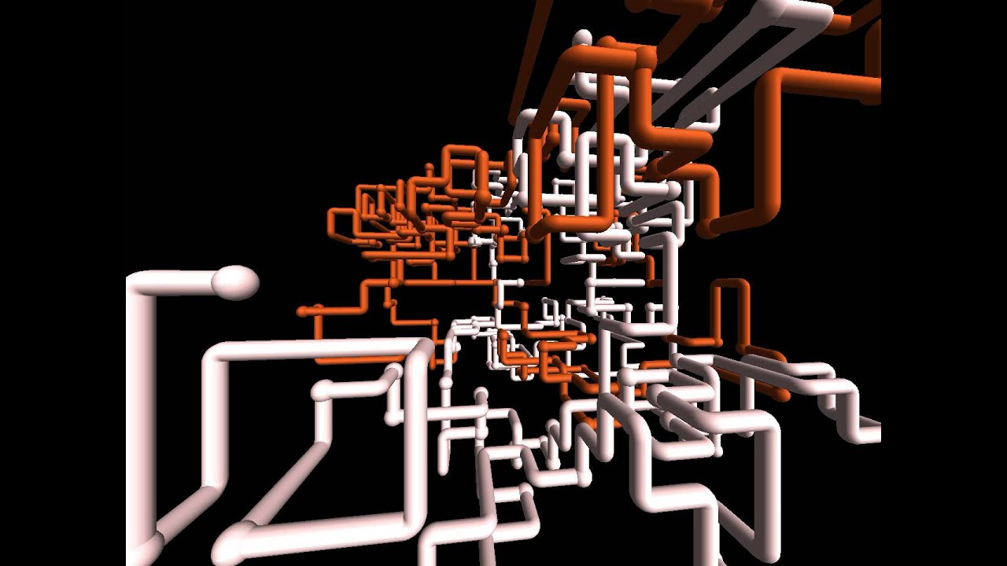

Pipelines with {targets}

Slide 2
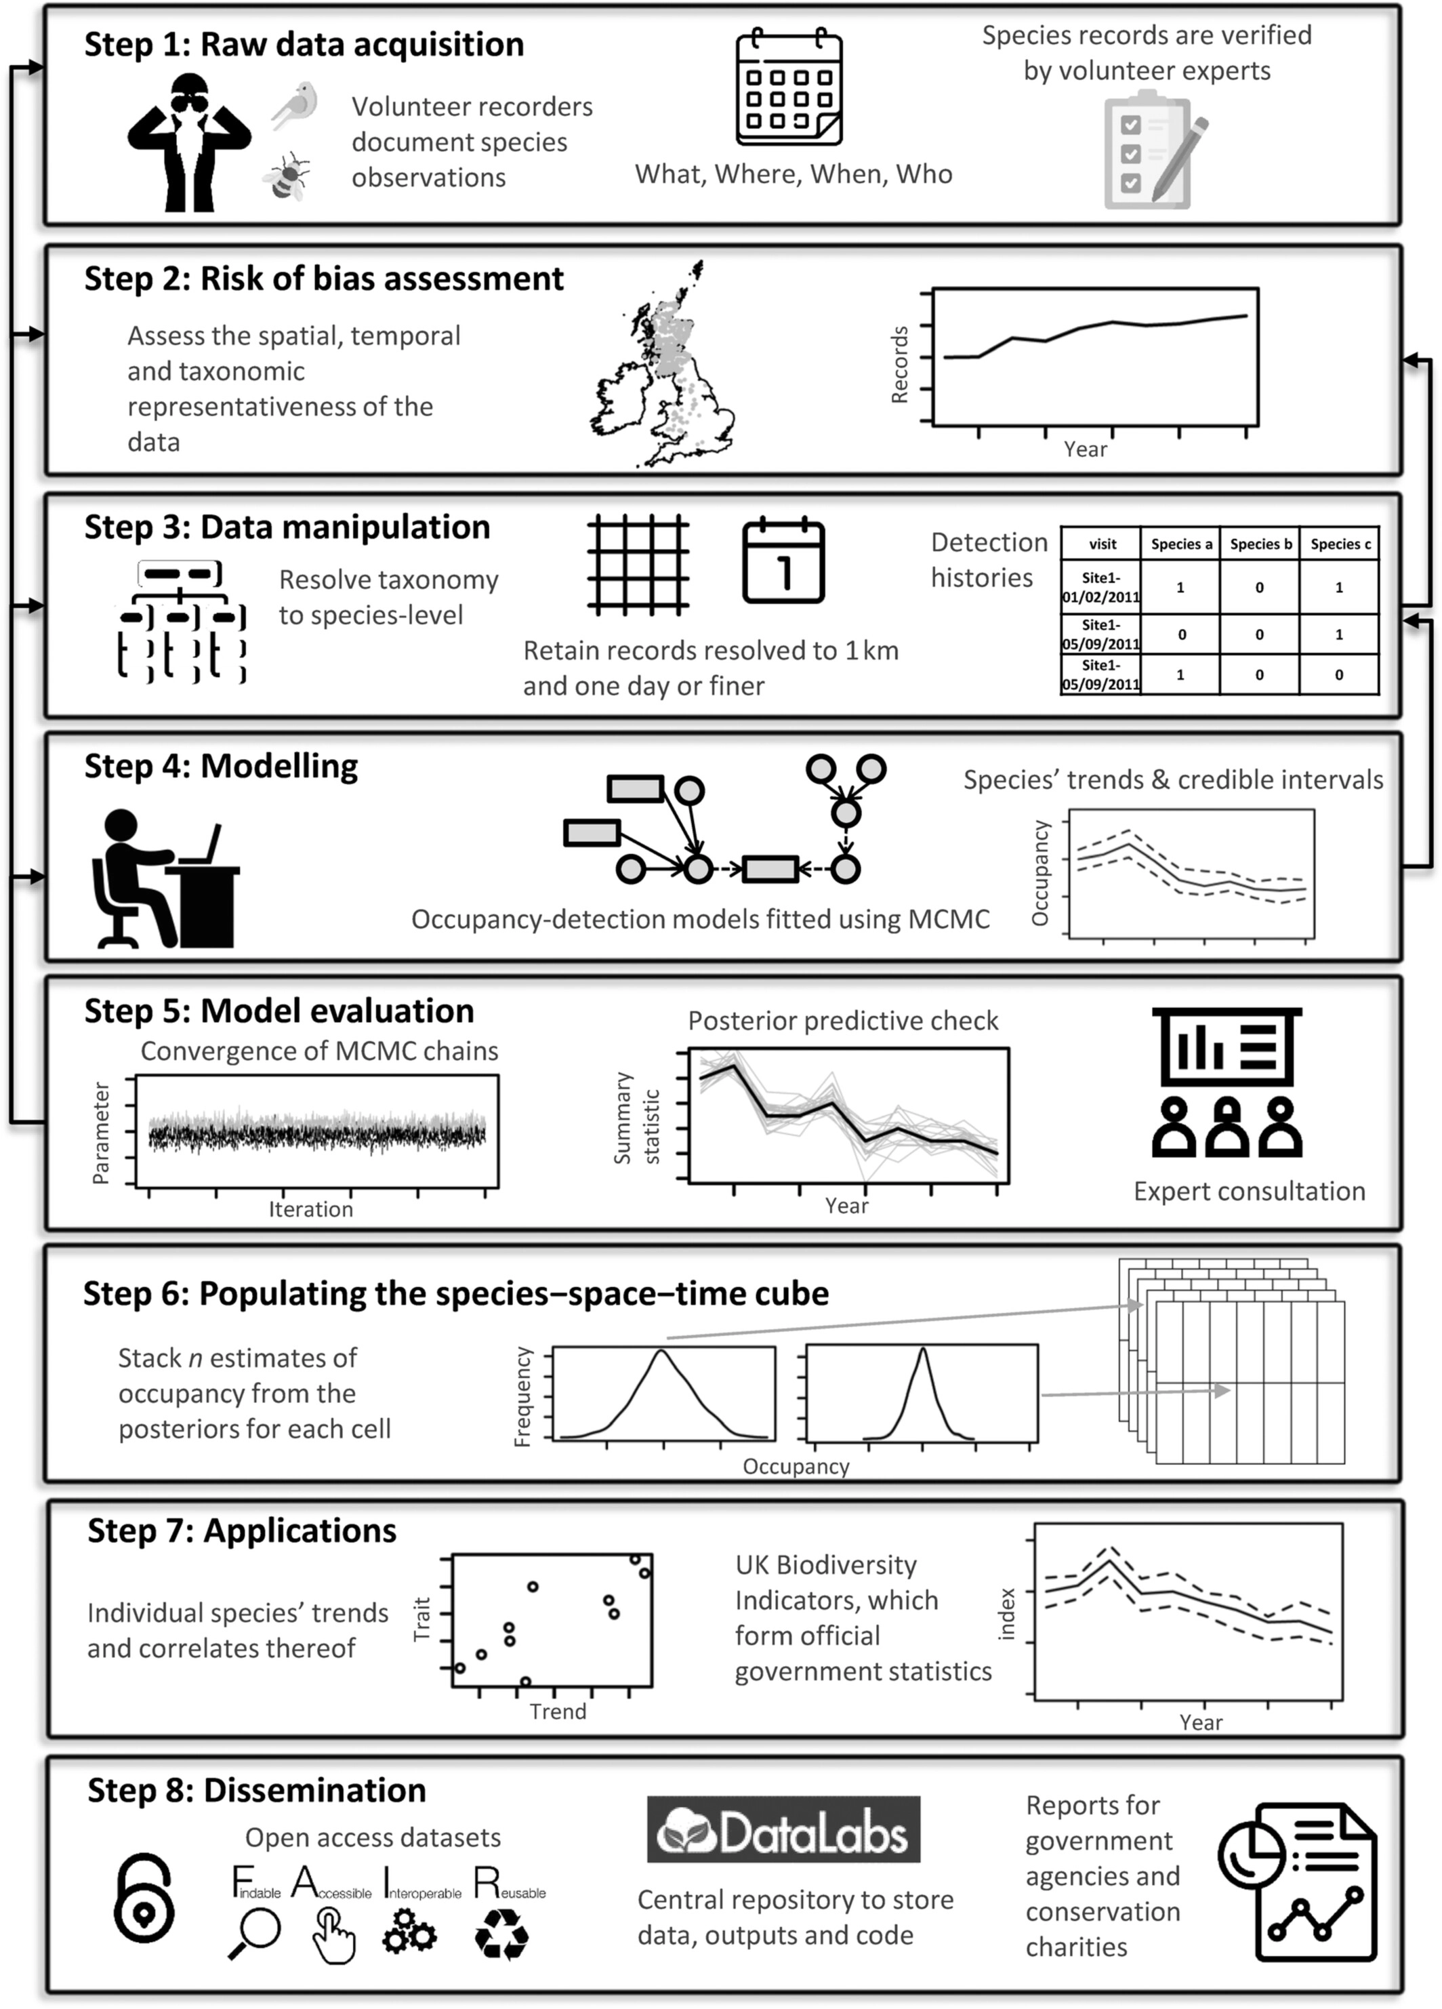
Workflows
A workflow typically describes the following:
The input data
The intermediate steps
The output data
The dependencies between the steps

Slide 3
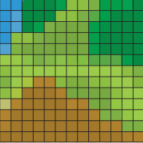
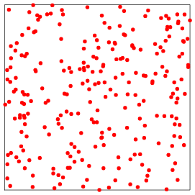
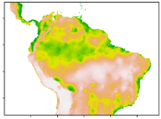
Example
Occurrence data
data/raw/occ_data.csv
Environmental data data/raw/env_data.tif
Cleaned occurrence with coviates
data/derived/occ_cov.RDS
Species distribution model object
model/sdm.RDS
SDM prediction
outputs/prediction.tif

Slide 4
Workflow
# Workflow in Rmarkdown
Loading and cleaning data
```{r}
#read data
occ <- readr::read_csv(“data/raw/occ_data.csv”)
env <- terra::rast(“data/raw/env_data.tif”)
df <- clean_and_prep_data(occ,env)
saveRDS(df,”data/derived/occ_cov.RDS”)
```
Fitting model
```{r}
df <- readRDS(”data/derived/occ_cov.RDS”)
mod <- glm(y ~ x, df)
saveRDS(mod, “model/sdm.RDS”)
```
Making predictions
```{r}
env <- terra::rast(“data/raw/env_data.tif”)
mod <- readRDS(“model/sdm.RDS”)
predictions <- predict(mod,env)
saveRDS(predictions, “outputs/prediction.tif”)
```
Occurrence data
data/raw/occ_data.csv
Environmental data data/raw/env_data.tif
Cleaned occurrence with coviates
data/derived/occ_cov.RDS
Species distribution model object
model/sdm.RDS
SDM prediction
outputs/prediction.tif

Slide 5
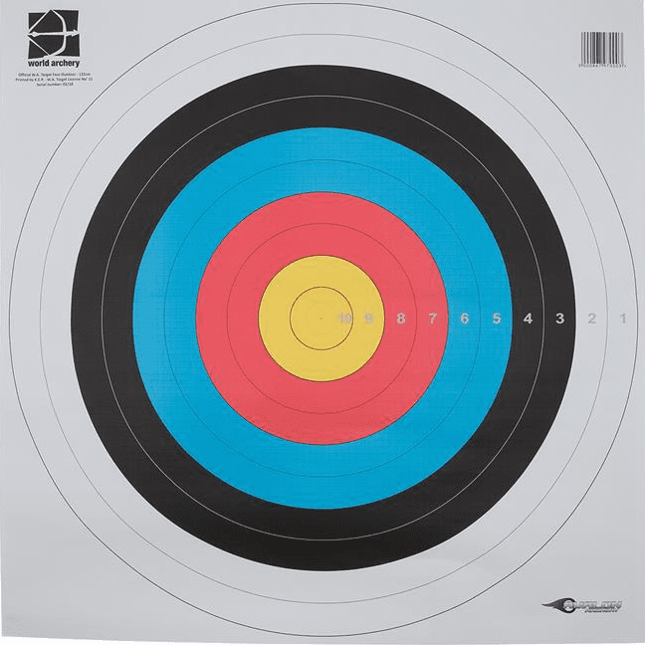
Pipelines work by defining “targets”
A target is defined with:
Input(s)
Output(s)
Call/script
Environment (sometimes implicit)
Declarative syntax
Describe desired results without explicitly listing commands or steps

Slide 6
Pipeline
Target 1
Input:
data/raw/occ_data.csv
data/raw/env_data.tif
Output:
data/derived/occ_cov.RDS
Call:
Rscript clean_and_prep_data.R
Target 2
Input:
data/derived/occ_cov.RDS
Output:
model/sdm.RDS
Call:
Rscript fit_model.R
Target 3
Input:
model/sdm.RDS
data/raw/env_data.tif
Output:
outputs/prediction.tif
Call:
Rscript predict_model.R
Occurrence data
data/raw/occ_data.csv
Environmental data data/raw/env_data.tif
Cleaned occurrence with coviates
data/derived/occ_cov.RDS
Species distribution model object
model/sdm.RDS
SDM prediction
outputs/prediction.tif

Slide 7
Pipeline
Target 1
Input:
data/raw/occ_data.csv
data/raw/env_data.tif
Output:
data/derived/occ_cov.RDS
Call:
Rscript clean_and_prep_data.R
Target 2
Input:
data/derived/occ_cov.RDS
Output:
model/sdm.RDS
Call:
Rscript fit_model.R
Target 3
Input:
model/sdm.RDS
data/raw/env_data.tif
Output:
outputs/prediction.tif
Call:
Rscript predict_model.R
# clean and prep data
occ <- readr::read_csv(input[[1]])
env <- terra::rast(input[[2]])
df <- clean_and_prep_data(occ,env)
saveRDS(df,output)
Occurrence data
data/raw/occ_data.csv
Environmental data data/raw/env_data.tif
Cleaned occurrence with coviates
data/derived/occ_cov.RDS
Species distribution model object
model/sdm.RDS
SDM prediction
outputs/prediction.tif

Slide 8
Ok so what’s the big deal?
Target 1
Input:
data/raw/occ_data.csv
data/raw/env_data.tif
Output:
data/derived/occ_cov.RDS
Call:
Rscript clean_and_prep_data.R
Target 2
Input:
data/derived/occ_cov.RDS
Output:
model/sdm.RDS
Call:
Rscript fit_model.R
Target 3
Input:
model/sdm.RDS
data/raw/env_data.tif
Output:
outputs/prediction.tif
Call:
Rscript predict_model.R
Essentially, pipelines are workflows with:
Automation
Does the ‘overhead’ for you:
Dependency tracking
When was it last re-run?
Has some data changed since it was rerun?
Altering one step eg. model fit, no need to re-run the whole pipeline
Visualisation: draws dependency graph
Easy transfer to HPC (depending on pipeline tool)

Slide 9

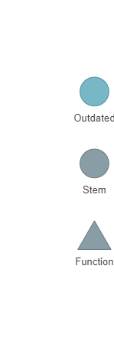
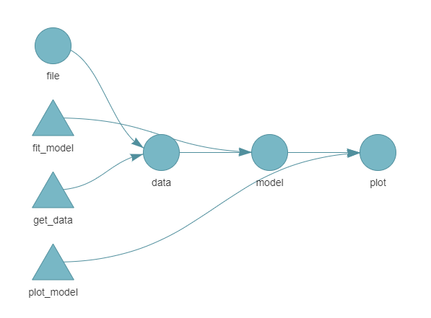
{targets}
install.packages(“targets”)
Part of ROpenSci
Function-orientated
R markdown friendly
Successor to {drake}
Focus on reproducibility of analyses (rather than high-throughput)
Static and dynamic branching
HPC functionality

Slide 10
Disadvantages / challenges
Harder to debug
More work to set up (but less work to maintain, extend, alter)
Learning curve: it’s a different mindset to sequential markdown documents (my previously preferred workflow approach)
Can be difficult to adapt an existing workflow

